Slide 1




20CS713 - C5
SINGLE IMAGE SUPER RESOLUTION
Mentor : Ms. S. D. Lalitha (Assistant Professor)

Slide 2

﻿ Group Members
Shalini V
111720102144
Venmathi J
111720102171
Yuvanthi S
111720102178

Slide 3
LITERATURE SURVEY

Slide 4

Abstract
The Super Resolution Image Project is a vital frontier in computer vision and image processing, with the primary objective of enhancing the resolution and quality of low-resolution images. It serves as a cornerstone for applications in various domains, including medical imaging, satellite imagery, and surveillance systems as it can help enhance the resolution and quality of such images, allowing for more accurate analysis and decision-making. The project typically comprises four crucial stages: dataset collection and preparation, model development and training, performance evaluation, and image application.

Slide 5
Enhanced Super-Resolution Generative Adversarial Networks
Enhanced Super-Resolution Generative Adversarial Networks" presents ESRGAN, an enhanced version of super-resolution generative adversarial networks (SRGAN) that achieves superior performance in SISR. The authors incorporate a residual-in-residual dense block (RRDB) into the generator network, enabling better feature extraction and reuse. Furthermore, they introduce a novel adversarial loss function that mitigates the problem of gradient vanishing, leading to sharper and
more realistic high-resolution images.
AUTHORS : X. Wang, K. Yu, S. Wu, J. Gu, Y. Liu, C. Dong .2018

Slide 6
Image Super-Resolution Using Very Deep Residual Channel Attention Networks
Image Super-Resolution Using Very Deep Residual Channel Attention Networks" presents a very deep residual channel attention network (RCAN) for image super-resolution. The RCAN architecture incorporates residual learning and channel attention mechanisms to effectively capture and exploit image features. By utilizing very deep networks, the method can learn complex mappings and generate high-quality super-resolved images. Experimental results show that the proposed RCAN model outperforms existing approaches and achieves state-of-the-art performance in terms of both quantitative metrics and visual quality
AUTHORS : X. Wang, K. Yu, S. Wu, J. Gu, Y. Liu, C. Dong .2018

Slide 7
Wide activation for efficient and accurate image super-resolution
The paper introduces a method called Wide Activation for efficient and accurate image super-resolution. By utilizing wide activation functions, the authors aim to enhance the representation capability of neural networks for super-resolution tasks. The proposed approach achieves improved efficiency and accuracy in image super-resolution compared to conventional methods.
AUTHORS : X. Yu et al., Jun. 2019

Slide 8
Stacked progressive auto-encoders (SPAE) for efficient and
accurate single image super-resolution
This paper introduces Stacked Progressive Auto-Encoders (SPAE) as an efficient and accurate approach for single image super-resolution. The authors propose a cascaded architecture of auto-encoders, where each subsequent auto-encoder learns residual information to refine the super-resolved output. SPAE exhibits effectiveness and accuracy in super-resolution tasks, delivering enhanced results compared to previous methods.
AUTHORS : W. Shi et al., Aug. 2019

Slide 9
Photo-Realistic Single Image Super-Resolution Using a
Generative Adversarial Network
Photo-Realistic Single Image Super-Resolution Using a Generative Adversarial Network" proposes a novel approach to single image super-resolution (SISR) using
a generative adversarial network (GAN). The GAN framework consists of a generator network that upscales low-resolution images and a discriminator network that distinguishes between the generated high-resolution images and the ground truth. The method achieves photo-realistic results by leveraging perceptual loss and adversarial training, surpassing the performance of previous SISR techniques
AUTHORS : W. Shi et al., Aug. 2019

Slide 10
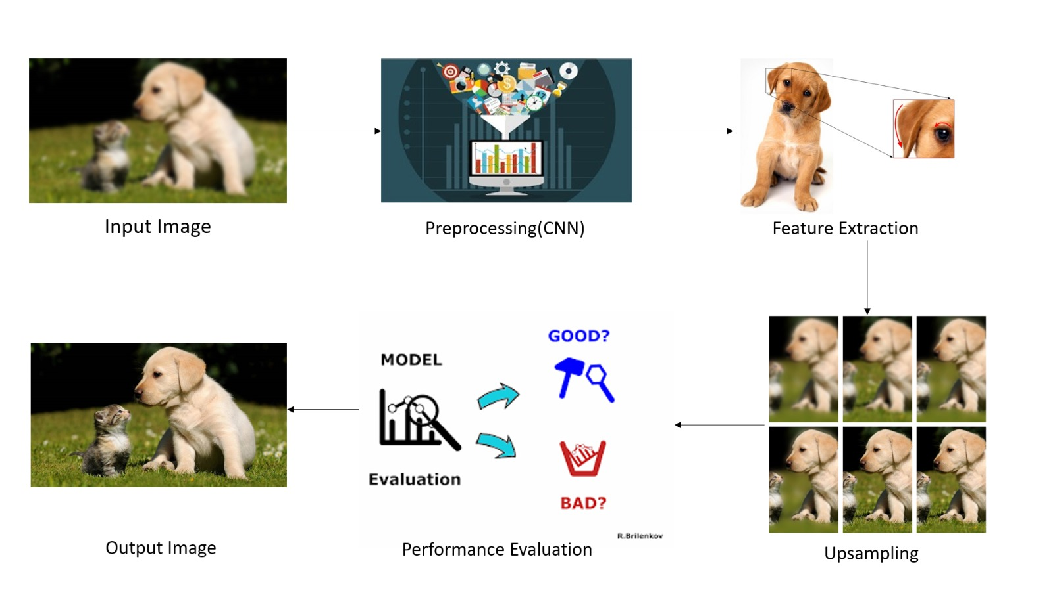
Flowchart

Slide 11
﻿Tech Stack
1
Python
2
Jupyter - IDE
3
CNN

Slide 12
﻿THANK YOU

